Slide 1

SE-Mini Project
QR Code Based Attendance App
Presented by : Group No.: 04
Under the Guidance of
PROF. PRAVIN PATIL
Assistant Professor
AY : 2023-24
Sr.No | Name | IDNo.
1 | SAHIL SANDEEP DESHMUKH | VU4F2223020
2 | MANTHAN NITIN SORKHADE | VU4F2223023
3 | ANURAG TIWARI | VU4F2223025
4 | VIVEK KUMAR SINGH | VU4F2223030

Slide 2
INDEX
Introduction
Literature Survey
Problem Statement
Objectives
Methodology
Technologies
Flowchart
Research Design
Conclusion
Future Scope
References

Slide 3
Introduction
TRADITIONAL SYSTEM
Traditionally attendance is marked on handwritten registers.
This process is to be repeated for each and every class or laboratory.
This leads wastage of precious class time.
QR CODE SYSTEM
This system is a web based system under the supervision of lecturers to generate the QR code and to collect data of the attendance

Slide 4
Literature survey
SR.NO. | NAME | YEAR | METHOD USED | LIMITATIONS
[1] | ScanIn: QR Code based Attendance System. | 2023 | Students checked in by scanning the QR code shared in their WhatsApp group. | Any Student present in the group can access the QR code.
[2] | QR Based Smart Student Attendance System. | 2023 | The QR code directed them to a Google form. | The use of a secondary app.

Slide 5
SR.NO. | NAME | YEAR | METHOD USED | LIMITATIONS
[3] | Android Based Mobile App for Attendance Using QR Code. | 2023 | Teacher will scan the QR Code of Individual Students. | Dependency on smartphones and internet may pose challenges in areas with poor network coverage.
[4] | Smart Attendance System Using QR Code. | 2023 | Enhance security by adding biometric authentication like fingerprint or facial recognition. | Collection of personal data raises privacy concerns.

Slide 6

Problem Statement
Time-Consuming Manual Processes.
Security and Accuracy Concerns.
Lack of Real-time Monitoring.
Limited Customization Options.
No Integration.
Environmental Impact.
Accessibility and User-Friendliness.

Slide 7

Objectives
Efficiency Improvement.
Real-time Monitoring and Reporting.
Customization Options.
Seamless Integration.
User-Friendly Interface.
Data Accuracy and Reliability.

Slide 8
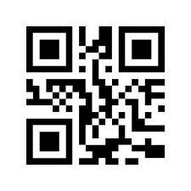

Methodology
Install the necessary libraries:
Install the libraries: qrcode, Pillow, and pyzbar using pip.
2. Design the user interface: Create a user-friendly interface that allows users to easily generate and scan QR codes, view attendance data, and generate reports. You can use a GUI toolkit like Tkinter

Slide 9

3. Generate QR codes: Use the qrcode library to generate unique QR codes for each event.
4. Scan QR codes: Use the pyzbar library to scan and validate QR codes.
5. Store attendance data: Use a database like SQLite to store attendance data.

Slide 10

6. Generate reports: Use a reporting library like ReportLab to generate attendance reports.
7. Test the app: Test the app thoroughly to ensure it is functioning as expected.
8. Deploy the app: Deploy the app to a web server or other distribution channels.

Slide 11




Technologies
Software
PyCharm
Kivy
MySQL
Python

Slide 12


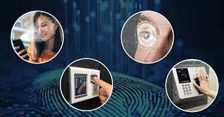
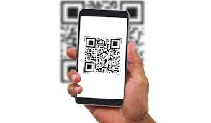
Hardware
Smartphone
QR Code Scanner
Biometric Sensors for Additional Security
Internet Connection

Slide 13
Flow Chart
Student information entered into the application.
Teacher scans QR code using the application.
QR Code generated by the application for each student.
Student attendance recorded in the application.

Slide 14

Research Design
Conduct controlled trials to measure accuracy and efficiency.
Manipulate variables like network connectivity and lighting conditions.
Collect quantitative data on attendance.

Slide 15
Conclusion
In conclusion, a QR code based attendance system is a modern and efficient way to manage attendance.
By using QR codes, the system can reduce attendance errors and improve accountability.
Overall, It can provide significant benefits in terms of cost savings, time efficiency, and student / employee accountability.

Slide 16
Future Scope
Enhanced Security Measures: Implement facial recognition or fingerprint scanning to restrict attendance marking to authorized individuals, enhancing system security.
GPS Location Data: Recording GPS location and time when attendance is marked, helping to filter out wrong times and locations.
QR Code On ID: The QR Code containing students information can be placed on their ID card.

Slide 17
References
[1] https://ieeexplore.ieee.org/document/10406947
[2] https://ieeexplore.ieee.org/document/9681472
[3] https://ieeexplore.ieee.org/document/10062969
[4] https://ieeexplore.ieee.org/document/10237132

Slide 18
Any Question?
Thank You !!

